Slide 1
DWT v. UWT
A statistical analysis
Varun Tulsiani Joshua Covarrubias Colby Nicodemus Andy Greenberg
Notes:
Varun

Slide 2
Executive Summary

Slide 3


What are Exchange Traded Notes ?
ETN

Slide 4
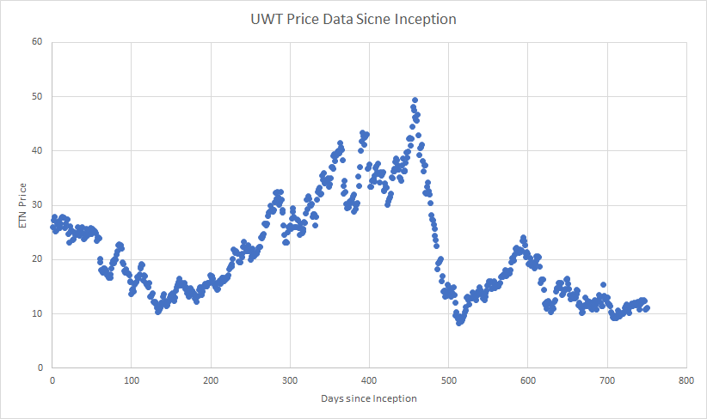
3X LNG CR OIL LNK S&P ETN NYSEARCA: UWT

Slide 5
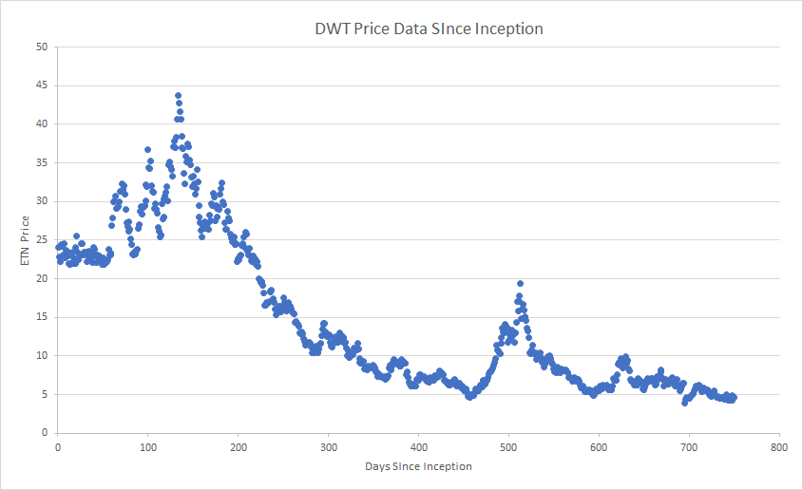
3x Inv Cr Oil ETNs linked to the S&P GSCI Crude Oil Index: DWT

Slide 6
Analytics Problem Framing

Slide 7
Problem Statement:
Other market pressures (supply/demand, expense ratio, delay) have an impact on the ETN pricing. This added volatility can increase risk for the investor leading to unexpected losses.
Questions:
First, are the price changes of UWT and DWT exactly inverse each day, as they should be?
If the price changes do deviate, what is causing this dependency?
Over the long term will the Investor of UWT have a greater or lower ROI compared to Crude Oil
Assumptions:
The Investor Fee Factor for each series of ETNs is as follows: 3x Long Crude Oil ETNs: 1.50% 3x Inverse Crude Oil ETNs: 1.50%
Average daily Volume of DWT: 24,588,526 Average daily Volume of UWT: 14,415,910

Slide 8
Hypothesis
Null- UWT Percent Change = -1(DWT Percent Change)
Alternative- UWT Percent Change ≄ -1(DWT Percent Change)

Slide 9
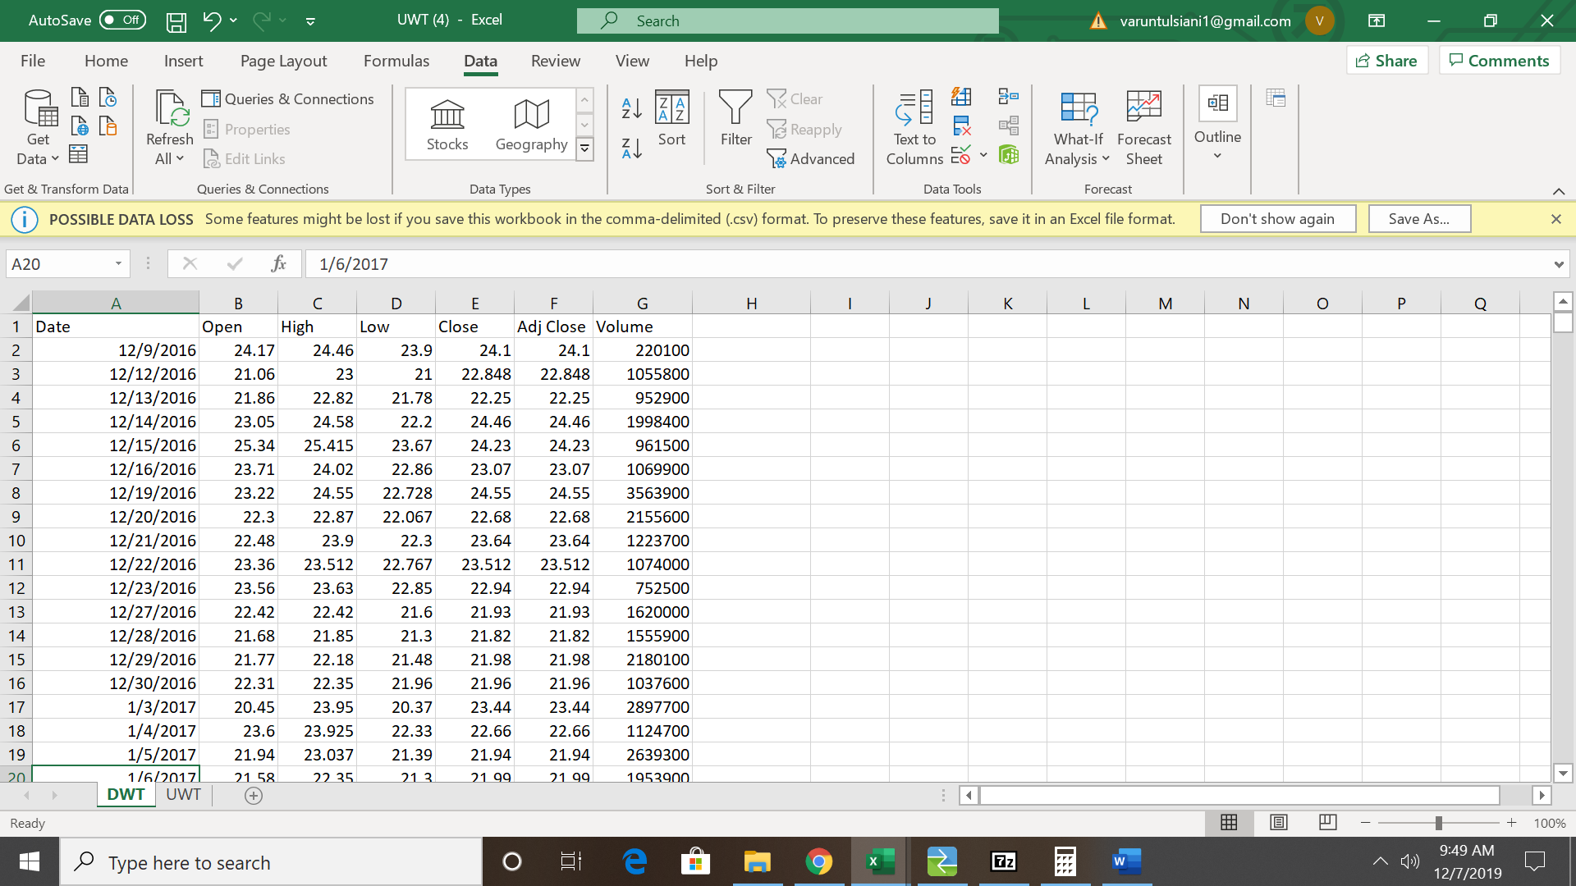
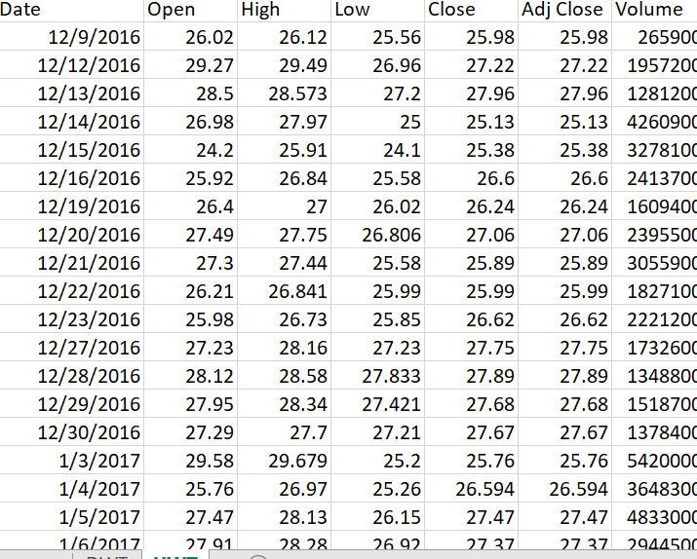
Data: Historical Time Series Price data since Inception; 2(751 rows by 7 Columns)

Slide 10
Methodology
Correlation
To test whether the price variances of the two ETNs are exactly Inverse
Regression
To understand what variables contribute to the price discrepancies between the two assets.
Forecasting
Would these ETNs be beneficial to an Investor over the long terms

Slide 11
Alternative Data and Methods Considered
Test Considered
Chi Square Test- only for categorical data
Forecasting- assets were perpetually depreciating
Regression- against volume and price changes was inconclusive
Alternative Data Sets Considered
USO- United States Oil Fund- was not directly related to UWT

Slide 12
-0.94458
Correlation Coefficient

Slide 13
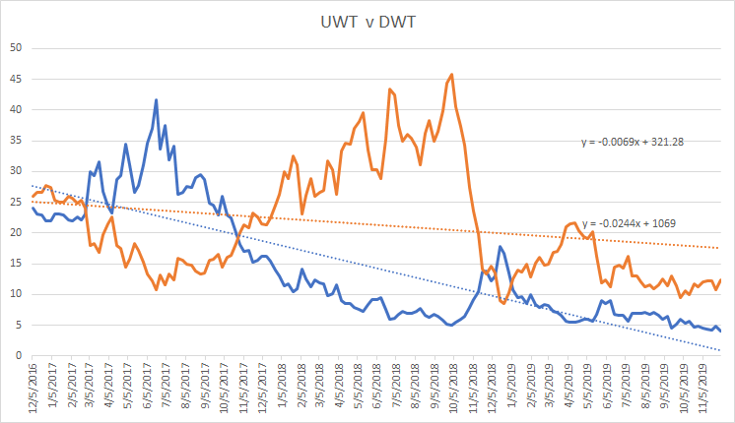

Slide 14
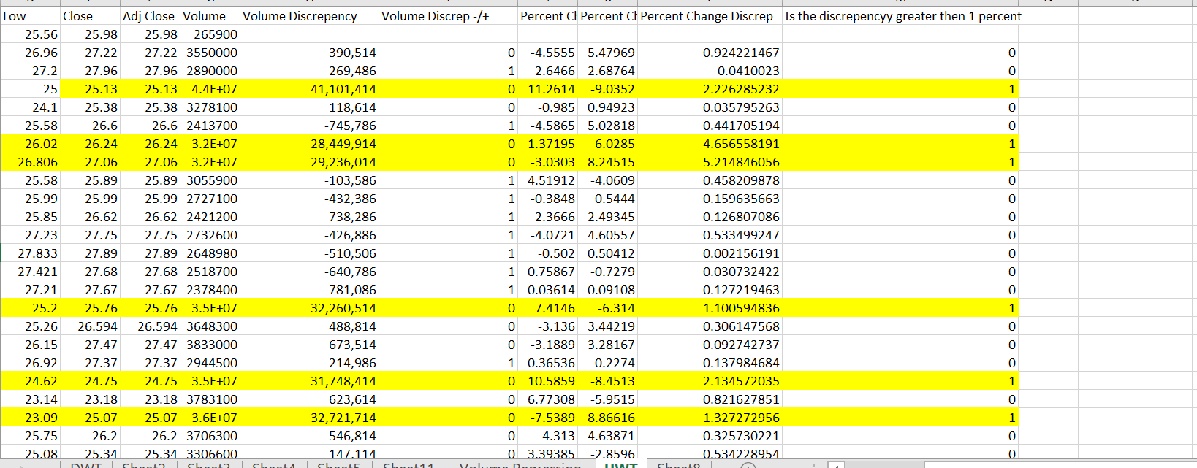

Slide 15
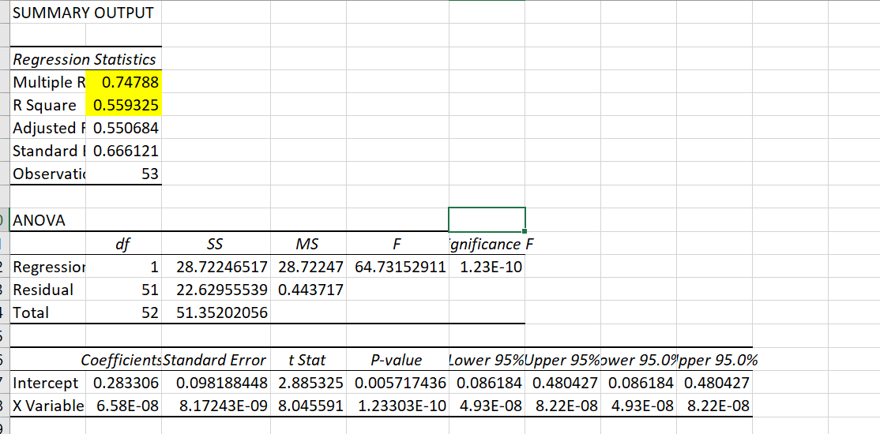
Regression; Test against Volume Discrepancies and Percent Discrepancies

Slide 16
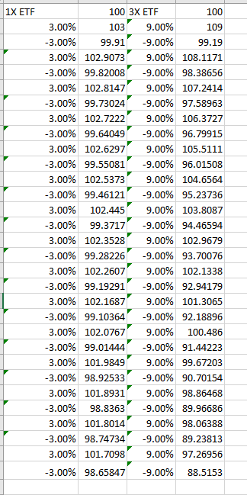
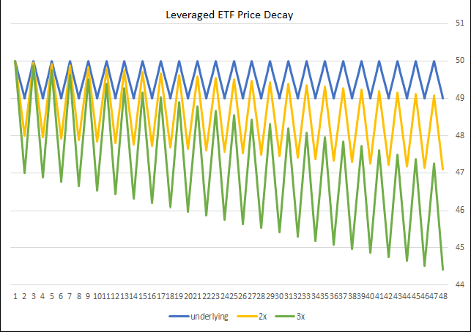

Slide 17
Conclusions
Yes, the Correlation Coefficient between the two assets should be -1, it was -.94. This may result in unexpected losses for traders betting on UWT.
Spikes in volume cause abnormally large price discrepancies between the two assets. Investors can track pumps in volume to gauge risk of discrepancy
Leveraged ETNs suffer from price decay over the long term, therefore an investor should consider alternative products
Is there a Price Discrepancy between the two ETNs
What is contributing to the discrepancies
Would an Investor benefit from either ETN when compared to their respective underlying asset?

